Slide 1
Writing small numbers in standard form
Standard form

Slide 2
How our teaching resources are designed for the classroom

Slide 3
I can write very small numbers in the form A × 10^{n} (where 1 ≤ A < 10) and appreciate the real−life contexts where this format is usefully used.

Slide 4

When a number is multiplied by itself multiple times, it can be written more simply in exponential form.
e.g.
The associative law states that a repeated application of the operation produces the same result regardless of how pairs of values are grouped. We can group using brackets.
Examples
Non examples
2.4 × 100 =
(48 ÷ 6) ÷ 2 =
4
2.4 × 10 × 10
24 ÷ 6
7 + 10
3 + (4 + 10) =
(3 + 4) + 10
48 ÷ (6 ÷ 2) =
16
48 ÷ 3

Slide 5
Standard form is when a number is written in the form A × 10^{n}, (where 1 ≤ A < 10 and n is an integer).

Slide 6

Writing small numbers in standard form
Writing very small numbers in standard form
Converting between ordinary and standard form
Standard form on the calculator

Slide 7
Writing very small numbers in standard form
A decimal has been written in all these forms.
Can you work out what the decimal is?
It is 0.021
There are an infinite number of ways to write 0.021, but only one using standard form. Using a standard approach to write very small numbers is important.

Slide 8

Writing very small numbers in standard form
Using standard form for big or small number is convention.
This is because we do not want a number to be written in so many different ways as this can be confusing.

Slide 9
Writing very small numbers in standard form
Using standard form for big or small number is convention.
A × 10^{n} where 1 ≤ A < 10 and n is an integer.
A must be a number between 1 and 10, including 1 and not including 10
n can be a positive or negative whole number.

Slide 10
Writing very small numbers in standard form
Using a place value chart is an excellent way to visualise the number and convert to standard form, but it does take time.
0 | 0 | 0
0 | 0 | 6
1 | 9
O
t
h
th
tth
hth
m
tm
hm
b
10⁰
10⁻¹
10⁻²
10⁻³
10⁻⁴
10⁻⁵
10⁻⁶
10⁻⁷
10⁻⁸
10⁻⁹

Slide 11
Writing very small numbers in standard form
Using the place value chart,
what do you think this number would be in standard form?
6.19 × 10⁻⁵
0 | 0 | 0
0 | 0 | 6
1 | 9
O
t
h
th
tth
hth
m
tm
hm
b
10⁰
10⁻¹
10⁻²
10⁻³
10⁻⁴
10⁻⁵
10⁻⁶
10⁻⁷
10⁻⁸
10⁻⁹
Let’s see if we can find a way without the place value chart.

Slide 12
Writing very small numbers in standard form
Without the place value chart, how do we write it in standard form?
Firstly, using the digit 6, 1 and 9, we make a number to satisfy
1 ≤ A < 10
So we know the standard form should look like this so far
6.19 × 10⬜
0 . 0 0 0 0 6 1 9
6 . 1 9

Slide 13

Writing very small numbers in standard form
Now, we count how many multiplications of we use to get 6.19 to 0.000 061 9
×
×
×
×
×
This means 6.19 = 0.000 061 9
In standard form 6.19 × 10⁻⁵ = 0.000 061 9
0 . 0 0 0 0 6 1 9
6 . 1 9

Slide 14
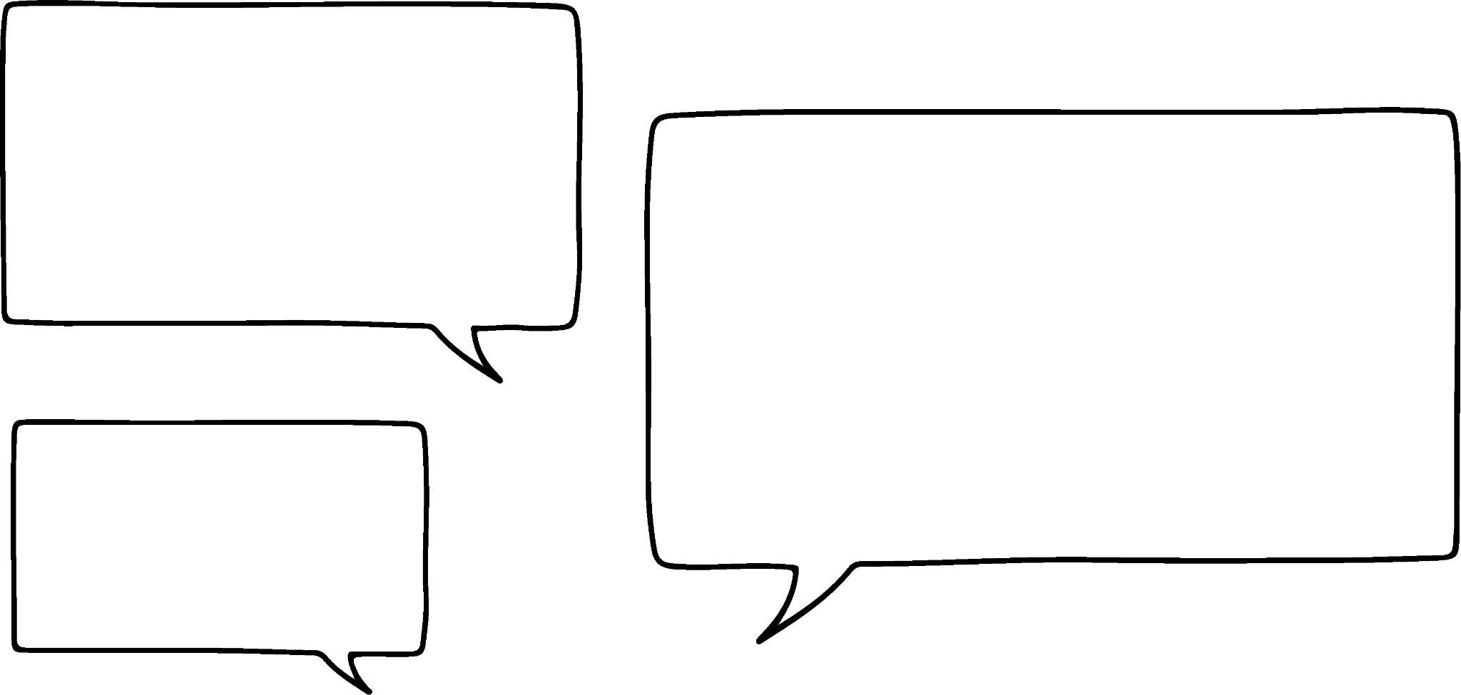



Writing very small numbers in standard form
Laura says she knows a shortcut.
Can you explain why Laura’s short cut works for small numbers?
For small numbers, the negative exponent tells you it is small and the number tells you how many zeros to put.
I see so 1.24 × 10⁻³ has an negative exponent, so I know it is small. The number in the exponent is 3 so there are 3 zeros.
0.00124
Laura
Sofia
When a number is correctly written in standard form the negative exponent is the number of divisions by 10.

Slide 15
Writing very small numbers in standard form
Convert the following into an ordinary number:
1.82 × 10⁻⁴
9.6 × 10⁻²
5.15 × 10⁻⁷
1.035 × 10⁻³
6.0045 × 10⁻¹⁰
= 0.000 182
= 0.096
= 0.000 000 515
= 0.001 035
= 0.000 000 000 600 45

Slide 16
Writing very small numbers in standard form
1) Using the place value charts, write the following in standard form.
a)
0 | 0 | 0
0 | 6 | 9
O
t
h
th
tth
hth
10⁰
10⁻¹
10⁻²
10⁻³
10⁻⁴
10⁻⁵
b)
0 | 0 | 1
2 | 8
O
t
h
th
tth
hth
10⁰
10⁻¹
10⁻²
10⁻³
10⁻⁴
10⁻⁵

Slide 17
Writing very small numbers in standard form
2) Which of the following are not in standard form? Explain why.
a) 123 × 10⁻⁹
b) 1.24 × 10⁻³
c) 0.96 × 10⁻¹
d) 12 300 ÷ 10¹⁰
e) 0.059 × 10⁸

Slide 18
Writing very small numbers in standard form
3) Without a place value chart, write the following in standard form.
0.000 000 354
0.001 45
0.000 000 000 563
0.048 6
0.000 000 000 631

Slide 19
Writing very small numbers in standard form
Using the place value charts, write the following in standard form.
a)
0 | 0 | 0
0 | 6 | 9
O
t
h
th
tth
hth
10⁰
10⁻¹
10⁻²
10⁻³
10⁻⁴
10⁻⁵
6.9 × 10⁻⁴
b)
0 | 0 | 1
2 | 8
O
t
h
th
tth
hth
1.28 × 10⁻²
10⁰
10⁻¹
10⁻²
10⁻³
10⁻⁴
10⁻⁵

Slide 20
Writing very small numbers in standard form
2) Which of the following are not in standard form? Explain why.
a) 123 × 10⁻⁹
b) 1.24 × 10⁻³
c) 0.96 × 10⁻¹
d) 12 300 ÷ 10¹⁰
e) 0.059 × 10⁸
This is incorrect as 123 needs to be a number satisfying 1 ≤ A < 10
This is in correct standard form.
This is incorrect as 0.96 needs to be a number satisfying 1 ≤ A < 10
This is incorrect as standard form uses multiplication.
This is incorrect as 0.059 needs to be a number satisfying 1 ≤ A < 10

Slide 21
Writing very small numbers in standard form
3) Without a place value chart, write the following in standard form.
= 3.54 × 10⁻⁷
0.000 000 354
0.001 45
0.000 000 000 563
0.048 6
0.000 000 000 631
= 1.45 × 10⁻³
= 5.63 × 10⁻¹⁰
= 4.86 × 10⁻²
= 6.31 × 10⁻¹⁰

Slide 22
Writing small numbers in standard form
Writing very small numbers in standard form
Converting between ordinary and standard form
Standard form on the calculator

Slide 23

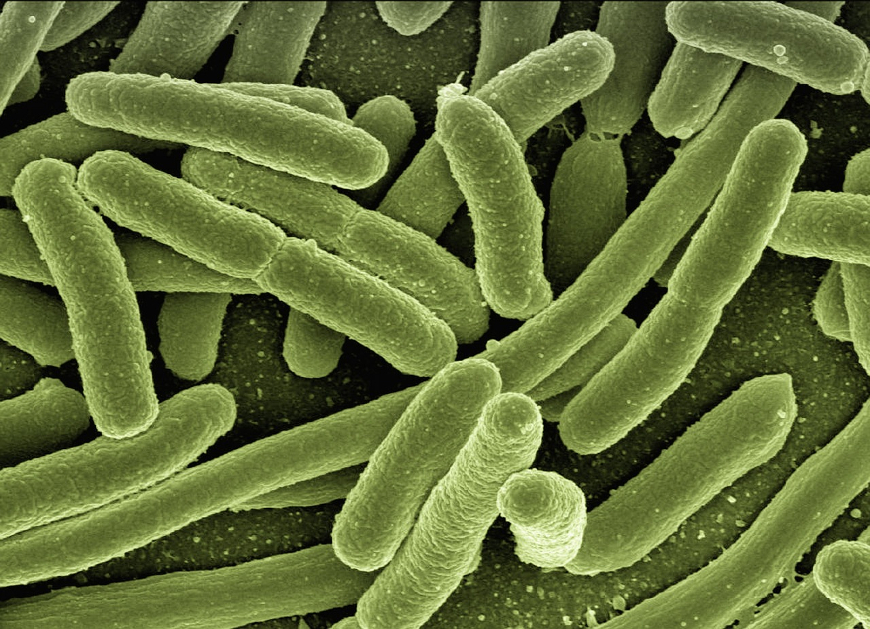

Converting between ordinary and standard form
Give some real life examples where we use very small numbers.
Nanotechnology
Biology or microbiology − looking at organisms, cells etc.
Microchips are virtually part of every electronic device across the globe

Slide 24
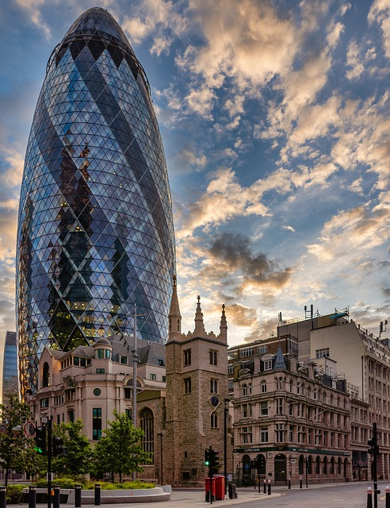

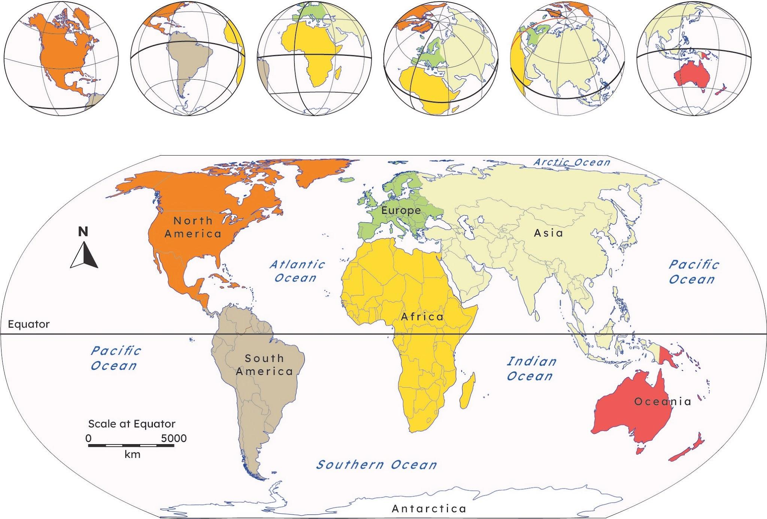
Converting between ordinary and standard form
Give some real life examples where we use very large numbers.
Global figures e.g. populations, distances, currencies
Construction and engineering
Astronomy where massive measurements are needed

Slide 25
Converting between ordinary and standard form
Some pupils have worked out the answers to these questions. Identify if they are correct or not and explain why.
780 000 in standard form.
780 000
7.8
92 300 in standard form.
92 300
92.3
There were 5 multiplications of 10 from the ones column.
There were 3 multiplications of 10 from the ones column.
7.8 × 10⁵
92.3 × 10³

Slide 26
Converting between ordinary and standard form
Some pupils have worked out the answers to these questions. Identify if they are correct or not and explain why.
780 000 in standard form.
780 000
7.8
This is correct.
They have created a number 7.8 using the digits 7 and 8 which satisfy 1 ≤ A < 10.
They have correctly counted the number of multiplications of 10 to make 7.8 into 780 000
There were 5 multiplications of 10 from the ones column.
7.8 × 10⁵

Slide 27
Converting between ordinary and standard form
Some pupils have worked out the answers to these questions. Identify if they are correct or not and explain why.
This is incorrect.
They have created a number 92.3 using the digits 9, 2 and 3 which do not satisfy 1 ≤ A < 10.
They have counted the number of multiplications of 10 to make 92.3 into 92 300
92 300 in standard form.
92 300
92.3
There were 3 multiplications of 10 from the ones column.
92.3 × 10³

Slide 28
Converting between ordinary and standard form
Convert the following into standard form.
0.000 000 263
652 000 000
0.005 63
892 000 000 000
0.000 000 000 000 000 3
30 004 000
0.000 300 4

Slide 29
Converting between ordinary and standard form
2) Convert the following into ordinary numbers.
2.31 × 10⁴
6.153 × 10⁻⁵
9.1565 × 10⁻⁶
2.48 × 10⁵
2.48 × 10⁻⁵
3.0065 × 10⁻⁹

Slide 30
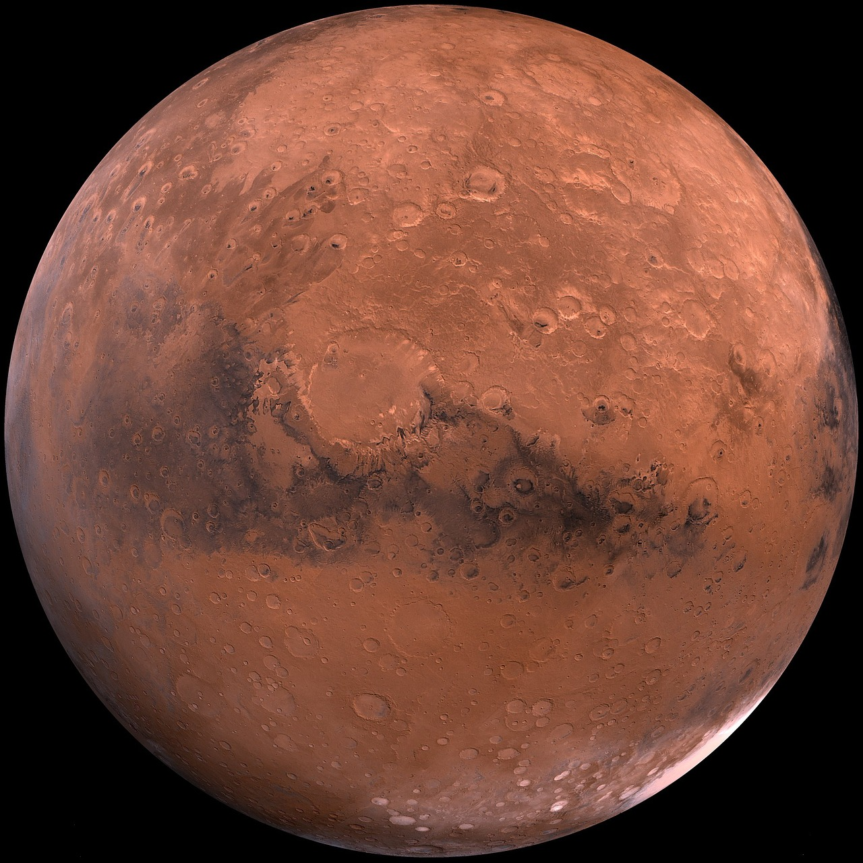

Converting between ordinary and standard form
3) A microchip has a width of 2 × 10⁻⁶ m. Write this as an ordinary number in cm.
4) Mars is approximately 225 million km away from Earth. Write this in standard form in m.
5) The radius of an atom is approximately
1 × 10⁻¹⁰ m. Write this an an ordinary number in mm.

Slide 31
Converting between ordinary and standard form
Convert the following into standard form:
0.000 000 263
652 000 000
0.005 63
892 000 000 000
0.000 000 000 000 000 3
30 004 000
0.000 300 4
= 2.63 × 10⁻⁷
= 6.52 × 10⁸
= 5.63 × 10⁻³
= 8.92 × 10¹¹
= 3 × 10⁻¹⁶
= 3.000 4 × 10⁷
= 3.004 × 10⁻⁴

Slide 32
Converting between ordinary and standard form
2) Convert the following into an ordinary number:
2.31 × 10⁴
6.153 × 10⁻⁵
9.1565 × 10⁻⁶
2.48 × 10⁵
2.48 × 10⁻⁵
3.0065 × 10⁻⁹
= 23 100
= 0.000 061 53
= 0.000 009 156 5
= 248 000
= 0.000 024 8
= 0.000 000 003 006 5

Slide 33

Converting between ordinary and standard form
3) A microchip has a width of 2 × 10⁻⁶ m. Write this as an ordinary number in cm.
4) Mars is approximately 225 million km away from Earth. Write this in standard form in m.
5) The radius of an atom is approximately 1 × 10⁻¹⁰ m. Write this an an ordinary number in mm.
0.000 002 m = 0.000 000 02 cm
225 000 000 km = 225 000 000 000 m = 2.25 × 10¹¹ m
0.000 000 000 1 m = 0.000 000 000 000 1 mm

Slide 34
Writing small numbers in standard form
Writing very small numbers in standard form
Converting between ordinary and standard form
Standard form on the calculator

Slide 35
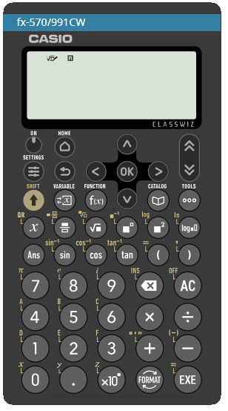
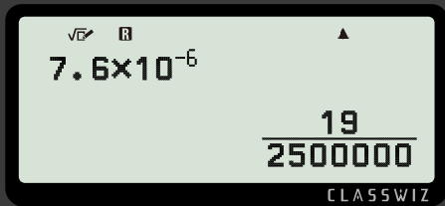

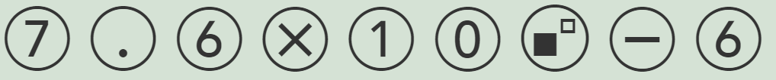


Standard form on the calculator
Let’s try converting 7.6 × 10⁻⁶ into an ordinary number
Using input
Pressing or
Select and change to a decimal
What happens?

Slide 36
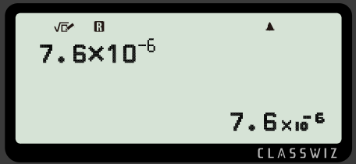
Standard form on the calculator
It will not convert it to a decimal.
It keeps the answer in standard form because the answer is so small.
Therefore it is important you are able to convert standard form to an ordinary number.
What is this as an ordinary number?
0.000 007 6

Slide 37

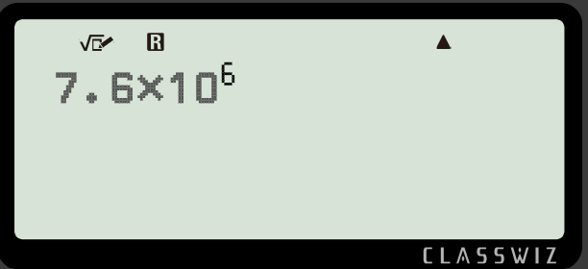
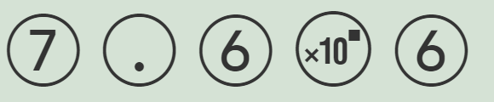

Standard form on the calculator
You can also use the button
Using input
Pressing or
Select and change to a decimal
The output will be the same

Slide 38
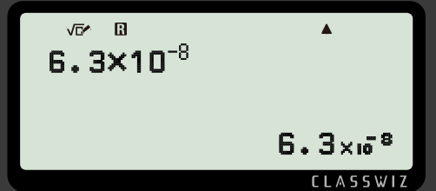
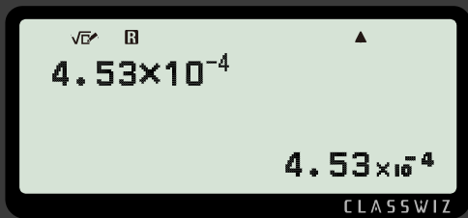
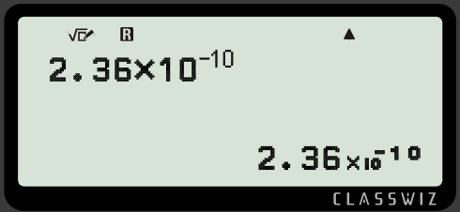
Standard form on the calculator
Write the following as a decimal.
0.000 000 063
0.000 453
0.000 000 000 236

Slide 39
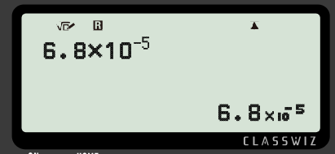
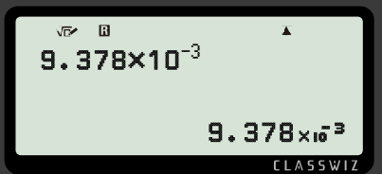
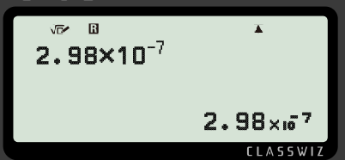
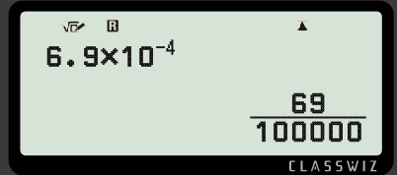
Standard form on the calculator
Write the output as a decimal.
a)
c)
b)
d)

Slide 40
Standard form on the calculator
2) Investigate when the number becomes so small that the calculator converts it into standard form.

Slide 41
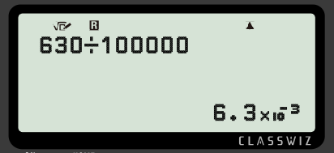
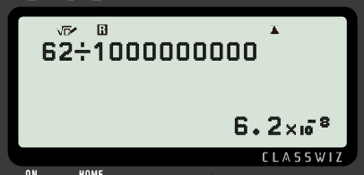
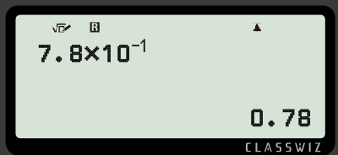
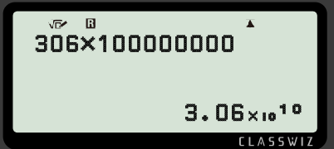
Standard form on the calculator
3) Fill in the missing information.
a)
c)
b)
d)

Slide 42
Standard form on the calculator
Write the output as a decimal.
a)
c)
0.000 068
0.009 378
b)
d)
0.000 000 298
0.000 69

Slide 43
Standard form on the calculator
2) Investigate when the number becomes so small that the calculator converts it into standard form.
Any number when written in standard form has an exponent less than or equal to −3

Slide 44
Standard form on the calculator
3) Fill in the missing information.
a)
c)
b)
d)

Slide 45
Writing small numbers in standard form
It is clear there is a need for standard form in real life, so it is important that incredibly large or small numbers can be written in standard form and vice versa.
A × 10^{n} where 1 ≤ A < 10 and n is an integer.
A must be a number between 1 and 10, including 1 and not including 10
n can be a positive or negative whole number.
When the exponent, n, is positive, the overall number is large. When the exponent, n, is negative, the overall number is small.

Slide 46

© Oak National Academy 2024.
Produced in partnership with Mathematics in Education and Industry.
Licensed on the Open Government Licence v3.0, except where otherwise stated. See Oak terms and conditions.

